Slide 1

Implement self-care strategies
CHCAGE013 - Work effectively in aged care (Release 1)

Slide 2



As an aged care worker, you will encounter a lot of stressors at work, including the following:
Being on the receiving end of aggression
The death or deterioration of an older person in your care
Complaints from an older person’s family or carers
Disagreements with other members of the care team
General job-related fatigue
Implement self-care strategies

Slide 3
Aside from taking care of older people, you must also take care of yourself. Being unable to do so may lead to your burnout. It may also lead to physical and mental health conditions.
This chapter will discuss how you can manage your work-related stress. Specifically, you will learn how to:
Monitor own stress levels when working with people
Use self-care strategies and seek support if required
Implement self-care strategies

Slide 4

4.1 Monitor Own Stress Level When Working With People

Slide 5
Stress is a condition people experience whenever they face new or challenging situations.
Stress level refers to the perceived extent of stress that you experience.
A high stress level indicates that you struggle with carrying out everyday activities.
Implement self-care strategies

Slide 6
Monitoring Stress Levels
The table shows some physical and emotional indicators of stress:
Physical Indicators | Emotional Indicators
Chest pain or rapid heart rate Trouble sleeping Muscle tension Digestive issues Headaches and nausea | Increased irritability and nervousness Low self-esteem Feeling like you are losing control Forgetfulness
Implement self-care strategies

Slide 7

To monitor your stress levels, you can try the following steps:
Understand how you respond to stress
Check upon yourself if you start to notice some changes in your body that can be stress-related.
Implement self-care strategies

Slide 8
To monitor your stress levels, you can try the following steps:
Understand how you respond to stress
You can use the following criteria to do this:
Attention - Ask yourself if you struggle to maintain your focus at work.
Mood - Ask yourself if you feel overwhelmed, pressured or anxious when doing your work tasks.
Implement self-care strategies

Slide 9
To monitor your stress levels, you can try the following steps:
Understand how you respond to stress
You can use the following criteria to do this:
Stamina - Ask yourself if you always feel exhausted after work.
Body - Check any irregular body response that you experience, like heartburn, palpitation, headache or dizziness.
Thoughts - Check whether your thoughts are becoming too negative
Implement self-care strategies

Slide 10

To monitor your stress levels, you can try the following steps:
Assign a rating scale for your stress level
Stress is subjective. This means only you can determine how much stress you are experiencing. Assigning a personal rating scale for your stress level can help you monitor it.
Implement self-care strategies

Slide 11
To monitor your stress levels, you can try the following steps:
Assign a rating scale for your stress level
You can refer to the suggestions below:
Construct your own rating scale
Take a few minutes at the end of the day to write about how you felt that day.
Make a mental note of any time you feel any of the previously mentioned physical and emotional indicators.
Implement self-care strategies

Slide 12
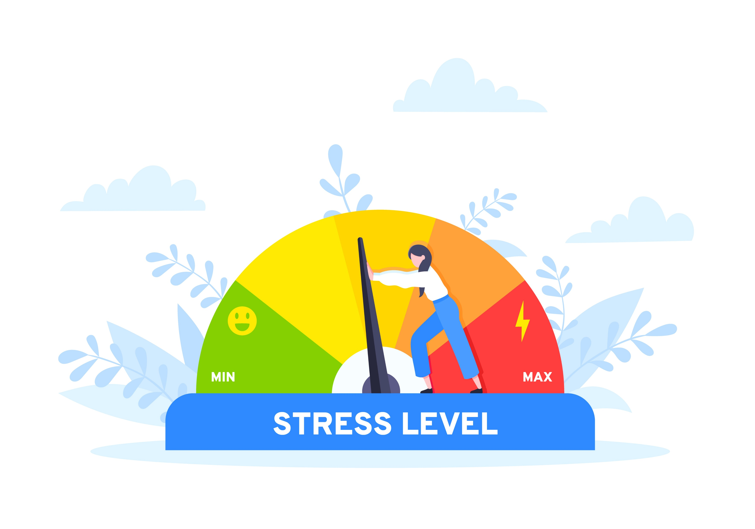
To monitor your stress levels, you can try the following steps:
Use a stress tracker
A stress tracker is a device that can be worn on your wrist. It monitors changes in your physical body like heart rate and sweat level, which are associated with your emotional state.
Implement self-care strategies

Slide 13

4.2 Use Self-Care Strategies and Seek Support if Required

Slide 14

There are many things you can do for yourself to deal with your work stress.
Taking care of yourself and seeking help keep you mentally healthy. Ignoring your stress can cause it to build up and bring you further harm.
Implement self-care strategies

Slide 15
4.2.1 Self-Care Strategies for Managing Stress
Self-care describes your ability to cope with stressors without professional help.
Remember that taking care of yourself makes you capable of taking care of others.
You must find effective self-care strategies to help you cope better with work-related stress.
Work Within an Aged Care Context

Slide 16
Self-Care Strategies
Samples of self-care strategies that you can follow are provided below:
Share your feelings.
Talking to your colleagues and sharing your feelings can help you feel better. You can also talk to your family and friends.
Take care of your health.
Getting adequate sleep and eating on time is necessary to maintain energy in the workplace. You must have the energy to assist older people with their daily needs.
Implement self-care strategies

Slide 17
Self-Care Strategies
Samples of self-care strategies that you can follow are provided below:
Learn to pace yourself at work.
Learn to acknowledge the limitations of your body. Remember to take a rest and refrain from handling multiple tasks at once, especially if doing so brings you severe stress.
Implement self-care strategies

Slide 18
4.2.2 Internal and External Services
There are services within and outside your organization that may help you in dealing with stress, trauma or vicarious trauma.
Stress is the feeling of being unable to cope with the pressures of your job.
Trauma is a response to an intensive negative event that a person has experienced.
Vicarious trauma is trauma felt after hearing about another person’s experiences.
Implement self-care strategies

Slide 19
Internal and External Services help aged care workers deal with work-related stress.
The table shows examples of these services:
Internal Services | External Services
Seminars within the organisation that teach stress-management techniques Quiet rooms that aged care workers and staff may access if they need some time to calm down | Seminars outside the organisation that teach stress management techniques Audiobooks on guided meditation that can help you de-stress
Implement self-care strategies

Slide 20
Internal and External Services help aged care workers deal with work-related stress.
The table shows examples of these services:
Internal Services | External Services
On-site counsellors or psychologists who can help you or refer you to outside help Mental health programs that an organisation can put in place for its workers | Counsellors or psychologists specialising in work-related trauma
Implement self-care strategies

Slide 21
Internal and External Services help aged care workers deal with work-related stress.
The table shows examples of these services:
Internal Services | External Services
Team meetings with other aged care workers and staff, specifically about coping with trauma | Organisations dedicated to supporting the mental health of carers, such as: Carers Australia Mental Health Carers Australia
Implement self-care strategies

Slide 22
Below are some services that can help you deal with work-related trauma and vicarious trauma:
Internal Services | External Services
Team meetings with other aged care workers and staff, specifically about coping with trauma | Organisations dedicated to supporting the mental health of carers, such as: Carers Australia Mental Health Carers Australia
Implement self-care strategies

Slide 23
States and territories also have their own support services for carers.
Carers refer to anyone who is taking care of a person with special needs. As an aged care worker, you are part of this group.
You must be in tune with your mental health and know how to seek help when needed. The sooner you can ask for help, the better your chances of taking control of your mental health at work.
Implement self-care strategies

Slide 24

4.2.3 Seeking Support
How do you know when it is time to seek support for your work-related stress and trauma?
To identify if you need to start seeking support, you can ask yourself the following:
Can I still handle it on my own?
Is my stress or trauma affecting my performance at work?
Implement self-care strategies

Slide 25
To identify if you need to start seeking support, you can ask yourself the following:
Is my stress or trauma affecting the way I interact with others?
Is my stress or trauma causing me to lose sleep?
Is my stress or trauma causing me to lose or gain weight?
Am I dreading going to work or seeing the people in my care?
Implement self-care strategies

Slide 26
If you answered ‘yes’ to most of these questions, then it may be time for you to seek support services.
Your workplace has policies and procedures on how you may seek support. This can include the following:
Communicating the support you requested
Documenting the support you requested
Addressing the recommendations for the support you requested
Implement self-care strategies

Slide 27

Communicating the support you requested
Request for support is related to your organisation’s policies on the health and well-being of its employees.
Communicate your request to your supervisor so they can relay it to the department in charge of employee welfare.
You may give either a verbal or written request, depending on the policy of your organisation.
Implement self-care strategies

Slide 28
Documenting the support you requested
In cases where you are required to file for a written form of request, know the documentation policies of your organisation.
Some may use electronic means where documentation is uploaded to an online portal.
Others may require you to fill out printed forms as well.
Implement self-care strategies

Slide 29
Addressing the recommendations for the support you requested
Your organisation will provide you with a support service from their available range of mental health assistance programs.
They can also provide a referral to an external counsellor service.
You must follow their terms, instructions and requirements relevant to accessing the support service.
Implement self-care strategies

Slide 30
In addition to the policies, you must be familiar with the organisational procedures for seeking support.
This includes the following:
Informing your supervisor of the support required
Requesting time off for requested external support
Implement self-care strategies

Slide 31
Informing your supervisor of the support required
Know your organisation’s procedures for informing your supervisor of the support you require.
Your supervisor will set a meeting to discuss your concern.
During the meeting, you will both decide on an action plan.
Implement self-care strategies

Slide 32
Requesting time off for requested external support
Follow your organisation’s procedures when asking for time off to receive external support.
You must indicate the complete details of your request, which may include the following:
Date of requested time off
The purpose for requesting time off
Additional evidence to support the request for time off
Implement self-care strategies

Slide 33

What have we learnt?
In this part of the session, we have covered:
Meet job role requirements
Work within organisational requirements
Work within an aged care context
Implement self-care strategies

Slide 34
End of Chapter 4

Slide 35

Presentation Objectives
Now that you have completed this presentation, you should be able to:
Meet job role requirements
Work within organisational requirements
Work within an aged care context
Implement self-care strategies

Slide 36
End of CHCAGE013 Presentation

Slide 37
Version Control & Document History
Date | Summary of Modifications | Version
4 January 2023 | Version 1.0 released for publishing | 1.0
14 April | Version 1.1 endorsed for use Minor revisions for improved readability | 1.1

